Slide 1
Make me
Your
Peace
The Prayer of Saint Francis

Slide 2
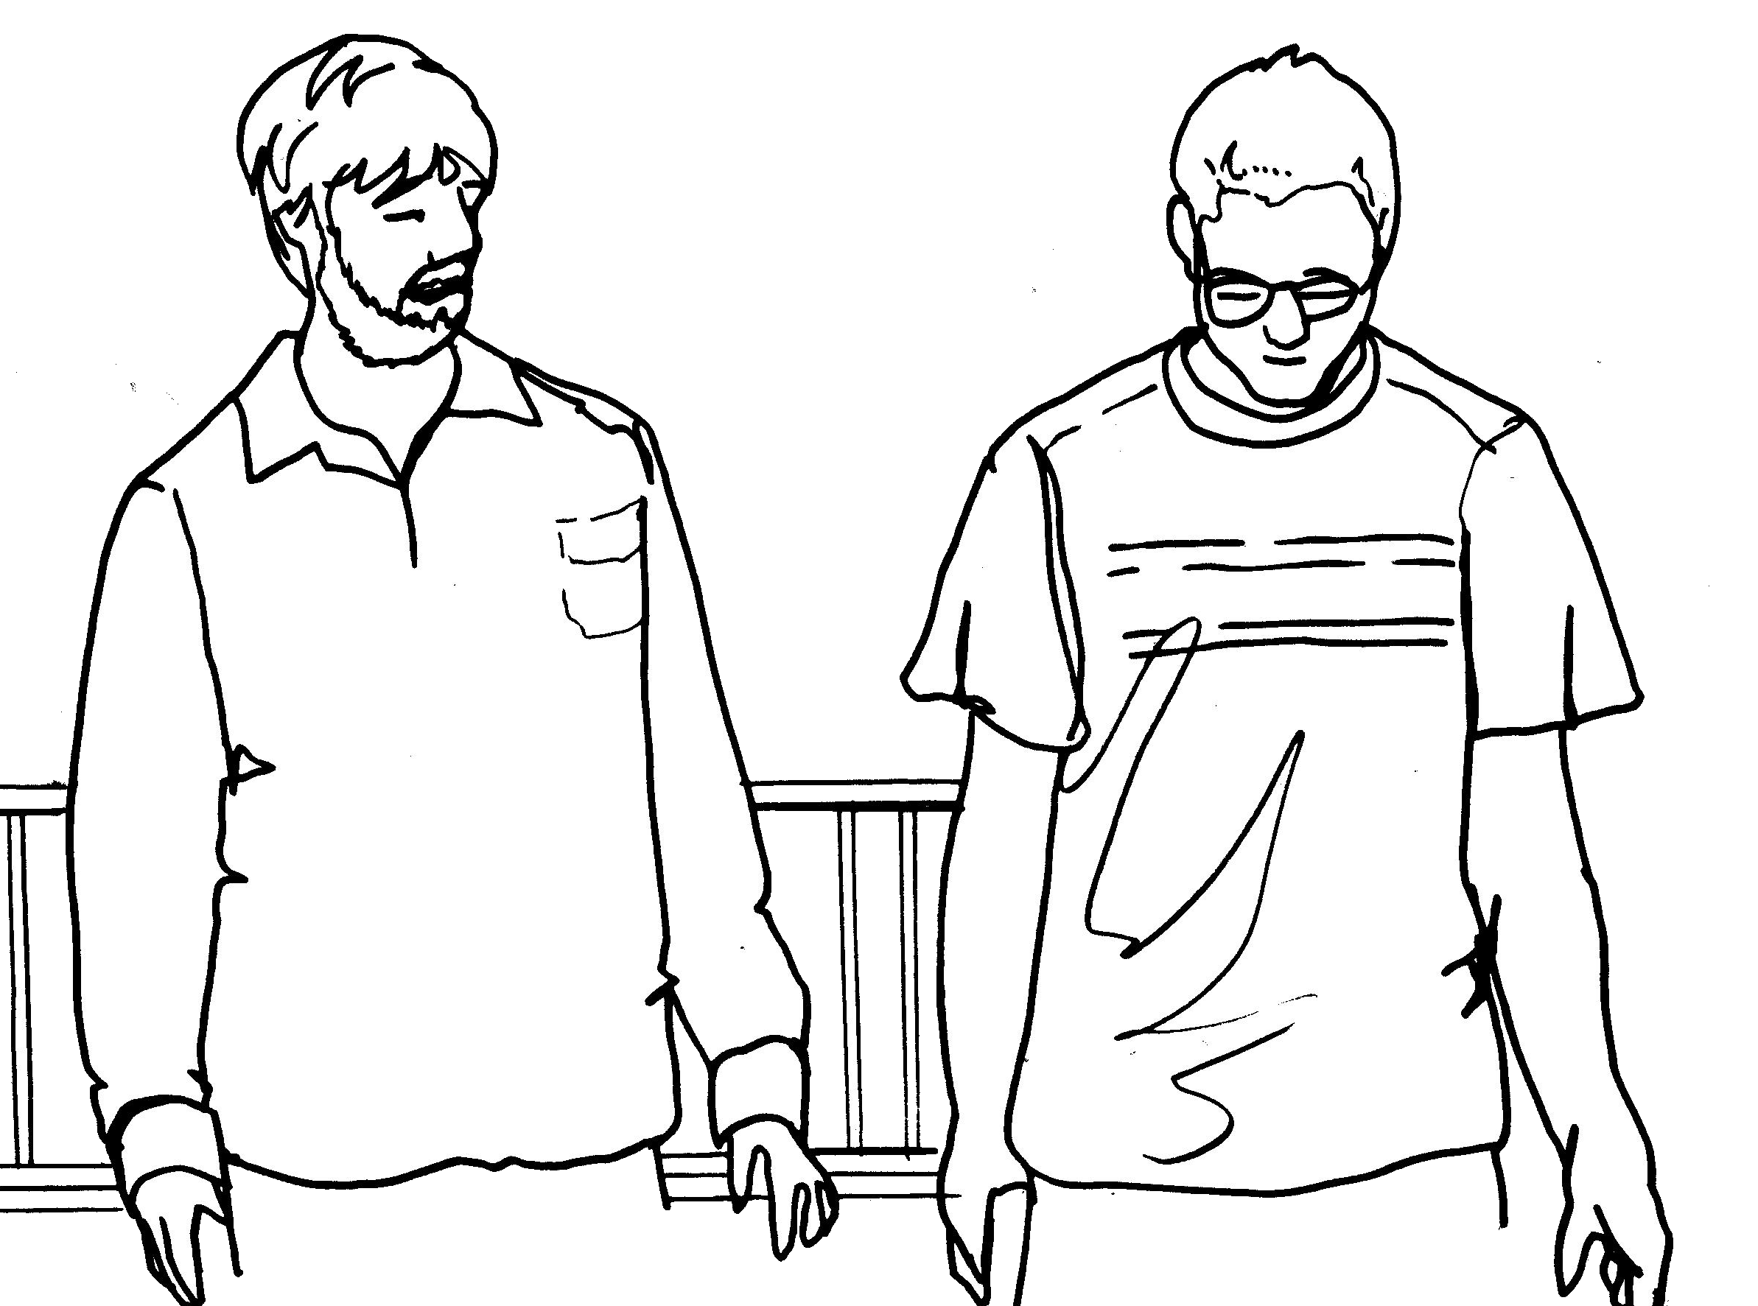
Where there is despair
let me
bring
Hope

Slide 3
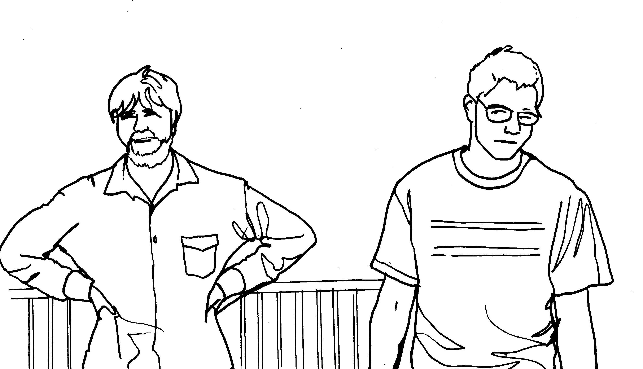
Where there is hatred
let me
bring
Love

Slide 4
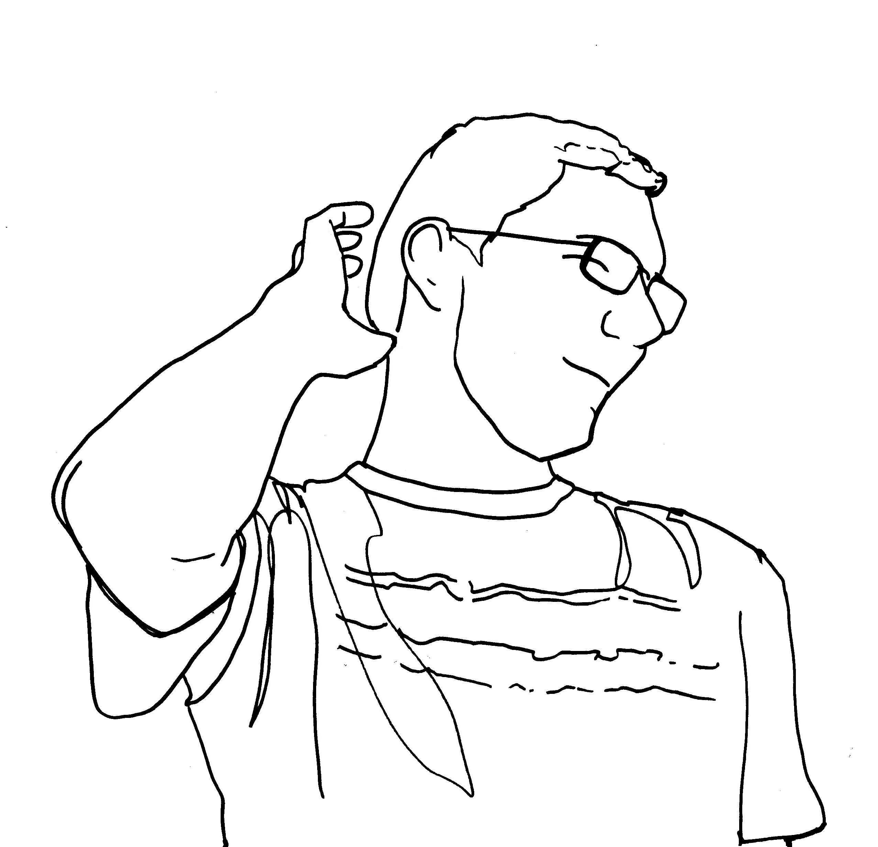
Where there is sadness
let me
bring
Joy!

Slide 5
Where there is injury
Your
Pardon
Lord

Slide 6
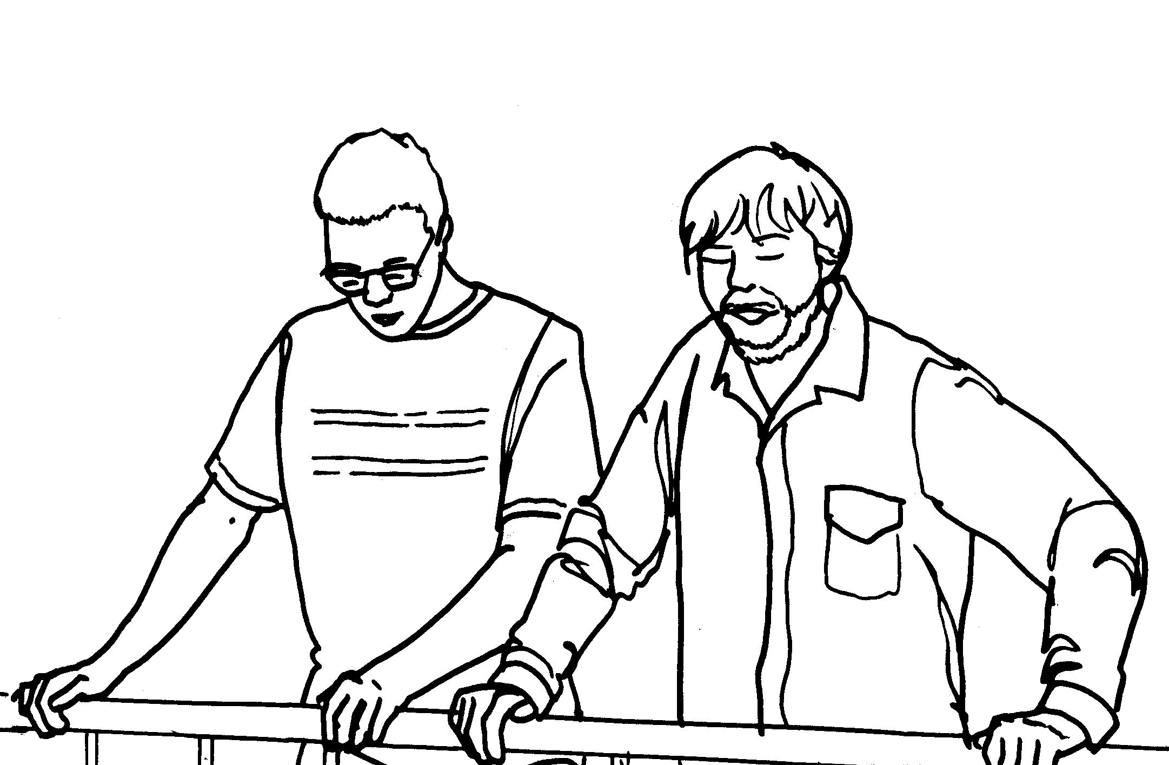
Where there is fear
True
Faith
in You

Slide 7
Make me
Your
Peace

Slide 8
Make me
Your
Peace
With My Love, Elizabeth Ann Nofs

